Slide 1
COP-290
ASSIGNMENT – 2 (subtask 2)

Slide 2
Design Choices:
Game Concept: The game revolves around the concept of collecting items and donating them while avoiding obstacles. This theme promotes the idea of charity and giving back to the community.
Graphics: Utilized images for game elements such as background, player, items, boxes, and obstacles. Images were scaled to fit the screen dimensions appropriately.
Sound: Integrated background music, sound effects for player-out scenarios, and button clicks to enhance the gaming experience.
User Interaction: Implemented keyboard controls for player actions like jumping and donating. Also, included interactive buttons for navigating the main menu, accessing options, and seeking help.
Menu Design: Designed a visually appealing main menu with buttons for Play, Options, Help, and Quit, accompanied by suitable background images.
Scoring System: Incorporated metrics for tracking the number of donations made, items collected, and the player's overall performance.
Obstacles and Challenges: Introduced obstacles to add challenge and excitement to the gameplay, requiring players to navigate skillfully to avoid collisions.

Slide 3
Implementation Highlights:
Sprite Animation: Implemented sprite animation for player movement, including running and jumping sequences.
Collision Detection: Utilized Pygame's collision detection methods to detect interactions between the player and game objects like items, boxes, and obstacles.
Game Loop: Implemented a game loop to manage the flow of the game, including updating player and object positions, handling events, and rendering graphics.
Menu Navigation: Developed a menu system allowing players to navigate between different screens, including the main menu, options, help, and game over screens.
Timer-based Spawning: Implemented timers to control the spawning of items, boxes, and obstacles at regular intervals, adding dynamic elements to the gameplay.
Dynamic Background: Created a scrolling background effect to simulate movement and enhance the visual appeal of the game environment.

Slide 4
Trade-offs:
Graphics vs. Performance: Balanced visual quality with performance optimization to ensure smooth gameplay even on lower-end devices.
Complexity vs. Accessibility: Struck a balance between adding complexity to gameplay (e.g., with obstacles) and keeping the game accessible to players of varying skill levels.Feature
Completeness vs. Development Time: Prioritized essential features and polished implementation over adding more complex mechanics within a limited development timeframe.
Sound vs. Silence: Considered the impact of sound on the gaming experience while ensuring options for players to toggle music based on preference or situation.

Slide 5
EXPLANATION OF CODE:
Getting Ready: At the beginning, the code sets up everything the user need run the game. It loads pictures for the game world, sets up the screen where the game will be shown, and prepares any sounds the user want to include.
Creating Characters and Objects: Next, the code defines how the player and other things in the game will behave. For example, it says how the player can move and jump, how items to collect will appear, and what happens when the player runs into obstacles. Here different sprite sheets are used to make the player run and jump
Playing the Game: Once everything is set up, the game starts running in a loop. This loop keeps checking if the player is doing something, like pressing keys to move or jump. It also updates where everything in the game is and shows it on the screen..
Menu Screens: The code includes screens for when you start the game, want to change options, or need help. These screens have buttons you can click to choose what you want to do. whenever the curser hovers on them , the colour changes too.
Responding to User: When user plays the game, the code watches for what he does, like pressing keys or clicking buttons. It then reacts accordingly, moving the player, showing different screens, or making things happen in the game world. SPACE key to jump and S key to donate
Scoring and Goals: While you play, the code keeps track of how well you're doing. It counts things like how many items you collect and donate. It also measures how long you stay alive and how many obstacles you avoid. Lastly, the code tries to balance different things to make the game fun and work well.

Slide 6
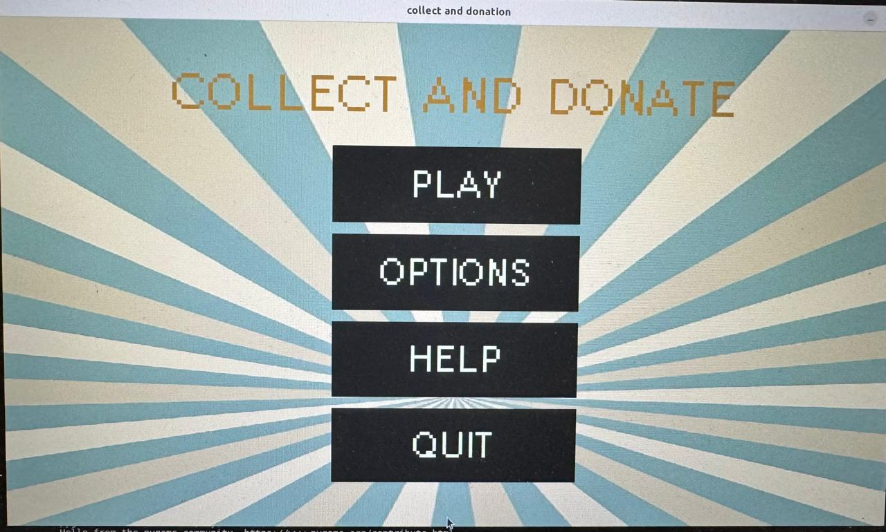
This is the menu page

Slide 7
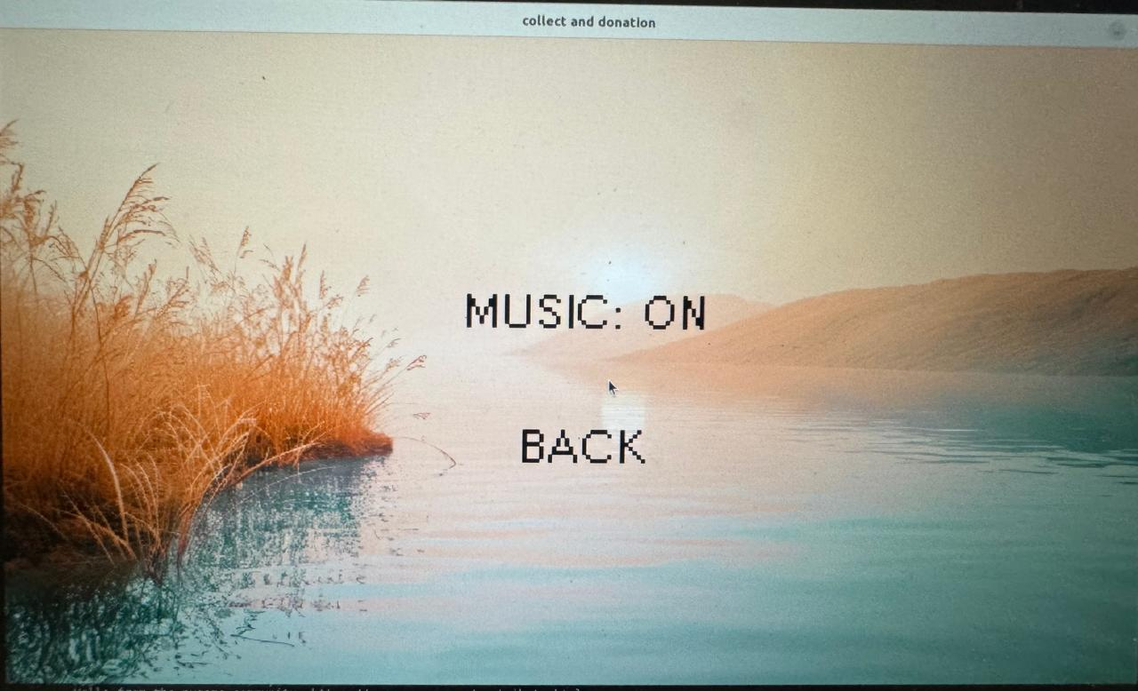
This is what we get when we click options on menu page.
You can off / on the music.

Slide 8
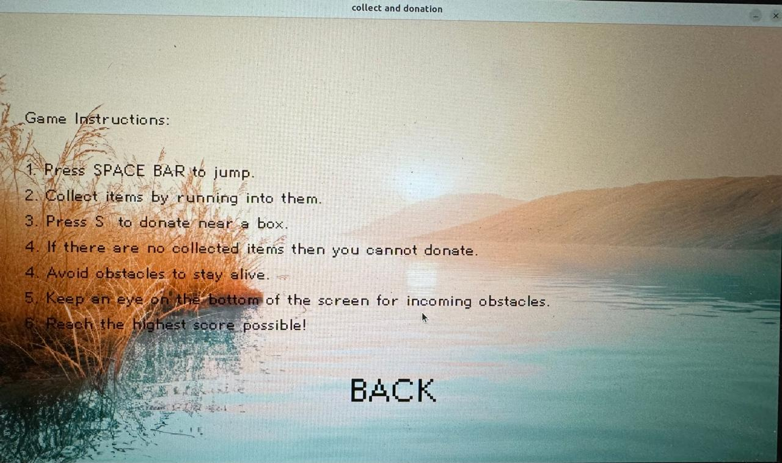
This is what we get when we click HELP.(its like mini manual)

Slide 9
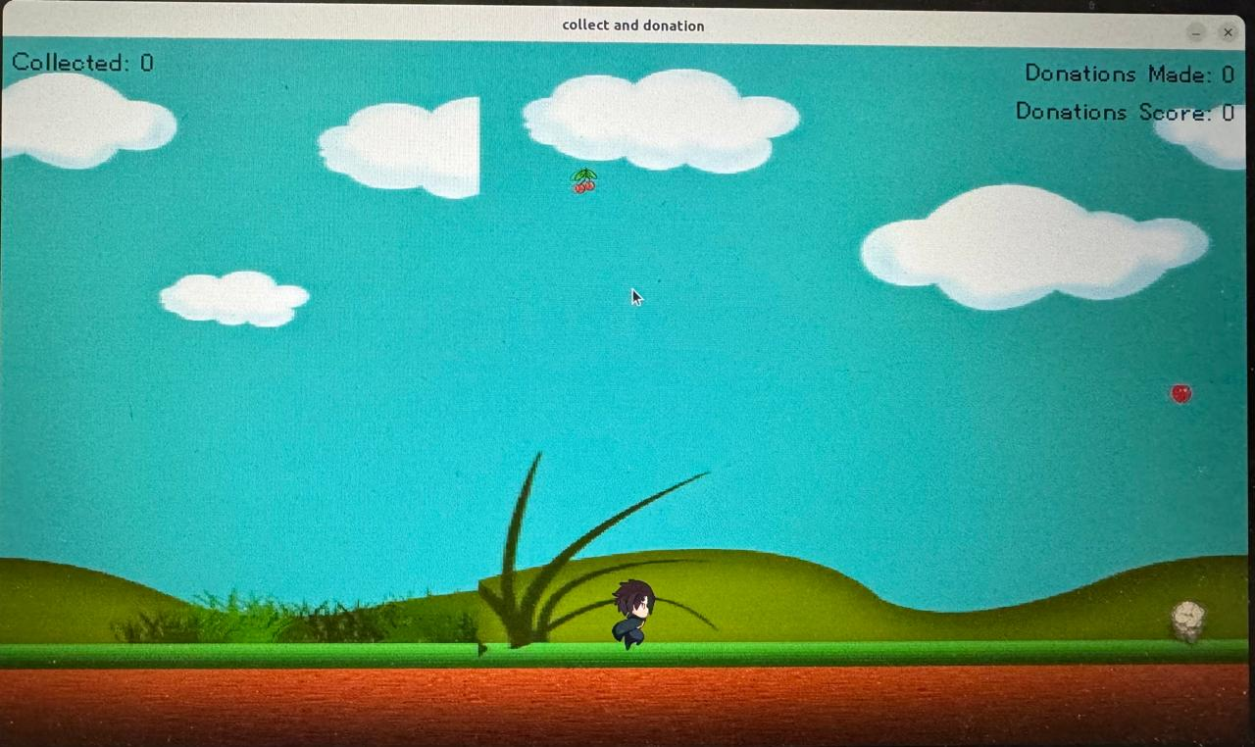

Slide 10
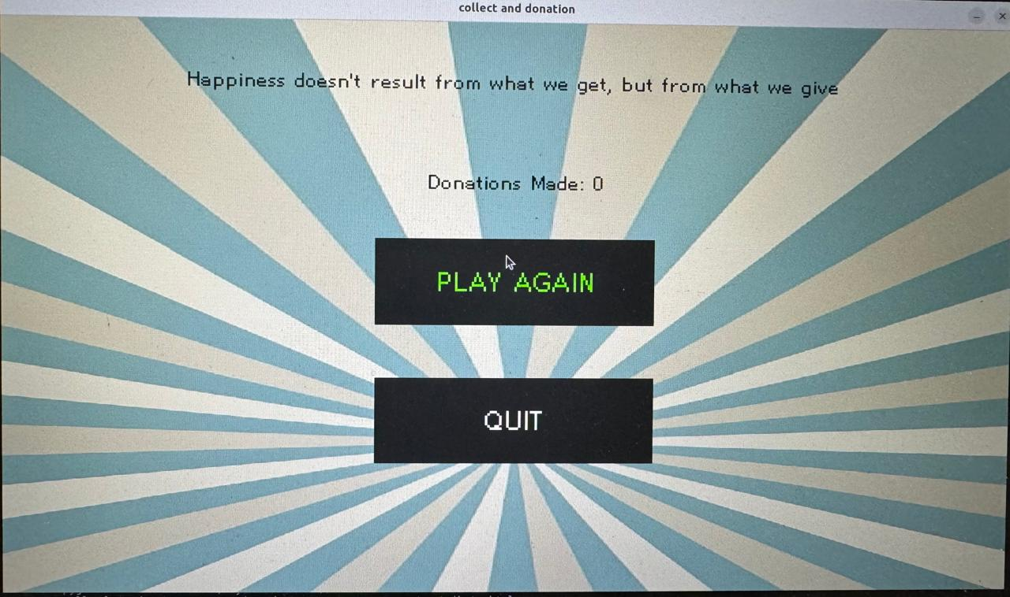
This is game over page……

